Slide 1
Vice President Public Relations
Club Officer Training

Slide 2
Vice President Public Relations (VPPR)
Vice President Public Relations Role
Vice President Public Relations Responsibilities
Vice President Public Relations Resources

Slide 3
Session Objectives
Identify your role within the club
Fulfill your responsibilities within the club and club executive committee
Find resources that help you fulfill your responsibilities

Slide 4
VPPR Role

Slide 5
VPPR Responsibilities
The Club Meeting
Outside the Club Meeting
The Executive Committee

Slide 6
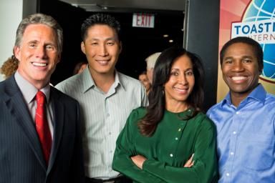
The Club Meeting
Before Club Meetings
Upon Arrival at Club Meetings
During Club Meetings

Slide 7
Before Club Meetings
Verify that information on website and social media is correct.
Order promotional materials.

Slide 8
During Club Meetings
Distribute promotional materials.
Report results of public relations efforts.
Announce public relations campaigns.
Solicit volunteers.

Slide 9
Outside the Club Meeting
Publicize the Toastmasters brand.
Promote the club.
Maintain the club website.
Join a Toastmasters-moderated social networking website.
Produce and distribute a club newsletter.

Slide 10
Outside the Club Meeting
Promote membership programs.
Attend club executive committee meetings.
Attend other Toastmasters events.
Arrange your replacement or assistance.
Prepare your successor for office.

Slide 11
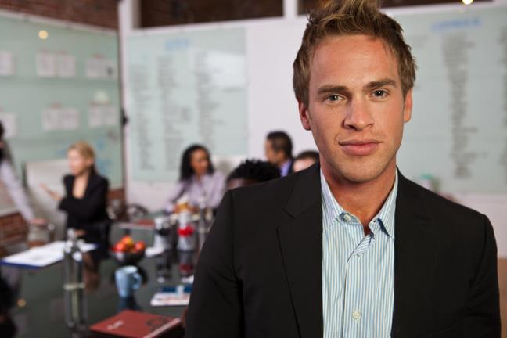
The Executive Committee

Slide 12
Executive Committee - Your Responsibility
Provide a public relations report.
Propose new promotion ideas.

Slide 13
How to Fulfill the VPPR Responsibilities
How
When
Who
What

Slide 14
VPPR Responsibility Action Plan
How will you fulfill this responsibility?
When will each action be completed?
Who is available to help you?
What materials and resources can you use?

Slide 15
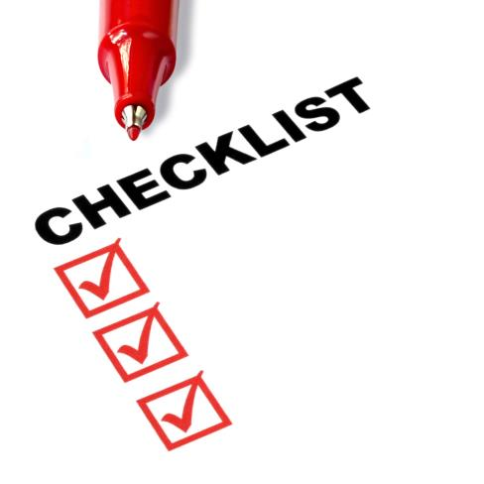
VPPR Resources

Slide 16
Getting Started
Attend district-sponsored club-officer training program.
Read materials.
Meet with outgoing executive committee.
Meet with outgoing vice president public relations.
Meet with current executive committee.
Invite one to three members to serve on public relations committee.

Slide 17
Getting Started
Review and order public relations materials.
Solicit articles for website.
Develop media list.

Slide 18
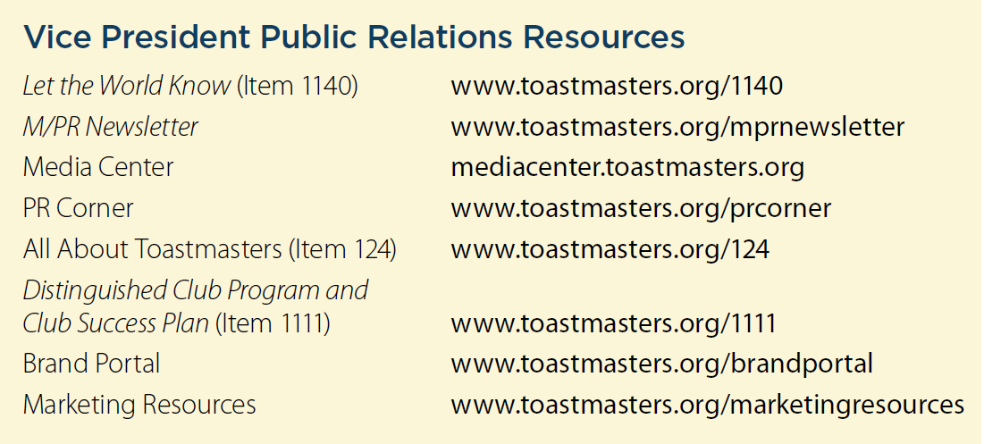
Additional Resources

Slide 19
This concludes the session.
Club Officer Training

