Slide 1
Sergeant at Arms
Club Officer Training

Slide 2
Sergeant at Arms (SAA)
Sergeant at Arms Role
Sergeant at Arms Responsibilities
Sergeant at Arms Resources

Slide 3
Session Objectives
Identify your role within the club
Fulfill your responsibilities within the club and club executive committee
Find resources that help you fulfill your responsibilities

Slide 4
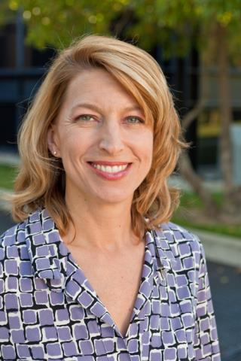
SAA Role

Slide 5
SAA Responsibilities
The Club Meeting
Outside the Club Meeting
The Executive Committee

Slide 6
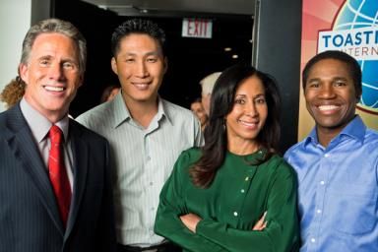
The Club Meeting
Before Club Meetings
Upon Arrival at Club Meetings
During Club Meetings
After Club Meetings

Slide 7
Before Club Meetings
Confirm room reservation.
Ensure there are club supplies.

Slide 8
Upon Arrival at Club Meetings
Arrange meeting room early.
Arrange tables and chairs.
Set out meeting materials and promotional materials.
Check room temperature.
Ask guests to sign the Guest Book.

Slide 9
During Club Meetings
Welcome late arrivals.
Coordinate food service, if any.
Collect ballots and tally votes when necessary.

Slide 10
After Club Meetings
Return room to original configuration.
Pack up and store materials.
Dispose of trash.

Slide 11
Outside the Club Meeting
Schedule meeting location.
Ensure adequate supplies are available.
Attend executive committee meetings.
Arrange your replacement or assistance.
Prepare your successor for office.

Slide 12
The Executive Committee

Slide 13
Executive Committee - Your Responsibility
Update the executive committee on the club meeting space status.
Work to coordinate meeting space.
Chair social and reception committee.
Replace items as needed.

Slide 14
How to Fulfill the SAA Responsibilities
How
When
Who
What

Slide 15
SAA Responsibility Action Plan
How will you fulfill this responsibility?
When will each action be completed?
Who is available to help you?
What materials and resources can you use?

Slide 16
SAA Resources

Slide 17
Getting Started
Attend district-sponsored club-officer training program.
Read materials.
Meet with outgoing executive committee.
Meet with outgoing sergeant at arms.
Meet with current executive committee.
Introduce yourself to meeting space contacts.
Ask for volunteers to assist you.

Slide 18
Additional Resources

Slide 19
This concludes the session.
Club Officer Training

