Slide 1
Creating a Quality Club
Club Officer Training

Slide 2
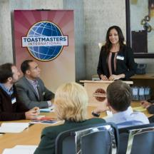
Agenda
Member Experience
Club Foundation
Teamwork

Slide 3
Session Objectives
Identify the elements that satisfy club members.
Correlate Moments of Truth and the Distinguished Club Program.
Apply Moments of Truth
Identify your leadership role

Slide 4
Member Experience

Slide 5
Club Quality
The Club
Moments of Truth
Experiential Learning
Self-paced program
Peer feedback
Mentoring
Values
Club Mission

Slide 6
Toastmasters’ Club Mission
We provide a supportive and positive learning experience in which members are empowered to develop communication and leadership skills, resulting in greater self-confidence and personal growth.

Slide 7
Toastmasters’ Values
Integrity
Respect
Service
Excellence

Slide 8
The Toastmasters Brand

Slide 9
Brand Positioning
I wasn’t born a leader. They were all around me though. In the community, at work, at school. Leaders were everywhere. They were the heads of families, coaches of teams, business leaders, mentors, organizational decision-makers.
I admired these leaders. They influenced who I was and who I was becoming. Whatever they did professionally or how they became what they were, I aspired to walk in their footsteps.
And, so, I committed myself to becoming one.
Finally, it came to me. It wasn’t just what leaders knew that enabled them to lead. They had a voice. They could tell their story. They could listen and answer. They didn’t just accomplish, they communicated.
So I set out to find my voice. Learn to process information on my toes. I needed to learn to listen. Learn to give feedback — and accept it. I needed to organize, plan, deliver, follow up. I needed a place where all the ingredients were there, and someone would guide me along the way.
I found that place. I found a community of learners and the path to leadership.
I am a leader — and I was made.

Slide 10
Brand Personality
Leader
Dedicated
Helpful
Empowering

Slide 11
Moments of Truth
First Impressions
Membership Orientation
Fellowship, Variety and Communication
Program Planning and Meeting Organization
Membership Strength
Achievement Recognition

Slide 12
Distinguished Club Program (DCP)
Members, who have the opportunity to earn education awards, are reaching their goals
Membership
With enough members, everyone’s experience is enhanced because leadership is provided and meeting and committee assignments are filled
Training
Trained club officers are better able to serve and support your club
Administration
Fulfilling administrative duties helps your club run more smoothly, which benefits members
Education

Slide 13
DCP Education Goals
Two CCs Two more CCs One ACB, ACS or ACG One more ACB, ACS or ACG One CL, ALB, ALS or DTM One more CL, ALB, ALS or DTM
Current Education Program
Two CCs Two more CCs One ACB, ACS or ACG One more ACB, ACS or ACG One CL, ALB, ALS or DTM One more CL, ALB, ALS or DTM
Toastmasters Pathways Learning Experience

Slide 14
Remaining DCP Goals
Four new members Four more new members
Membership
A minimum of four club officers trained during each of two training periods
Training
On-time payment of membership dues accompanied by the names of eight members (at least three of whom must be renewing members) for one period and on-time submission of one club officer list
Administration

Slide 15
Distinguished Club Program (DCP)
Members, who have the opportunity to earn education awards, are reaching their goals
Membership
With enough members, everyone’s experience is enhanced because leadership is provided and meeting and committee assignments are filled
Training
Trained club officers are better able to serve and support your club
Administration
Fulfilling administrative duties helps your club run more smoothly, which benefits members
Education

Slide 16
Teamwork

Slide 17
The Gestalt Approach to Teamwork
The whole is greater than the sum of its parts.
Know your role.
Know the roles of your teammates.
Communicate your areas of strength.
Take a proactive approach.
Be willing to cover for another officer.

Slide 18
The Executive Committee
President
Vice president education (VPE)
Vice president membership (VPM)
Vice president public relations (VPPR)
Secretary
Treasurer
Sergeant at arms (SAA)

Slide 19
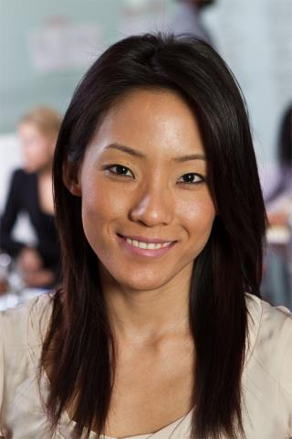
The President
Sets the tone for the club
Provides helpful, supportive leadership
Facilitates communication
Knows membership levels and progress
Serves as Base Camp Manager

Slide 20
The President
Ensures executive officers are functioning well and the club focuses on Distinguished club status
Guides the executive committee and club towards goals

Slide 21
President
Transferable skills include:
Experience in leadership
Leading teams
Meeting goals
Motivating and coaching others

Slide 22
The VPE
Encourages members to complete their communication and leadership goals
Schedules member speeches and projects
Serves as Base Camp Manager

Slide 23
The VPE
Serves as a resource for questions about education awards, speech contests and mentors
Is a source for Toastmasters knowledge and the education program

Slide 24
VPE
Transferable skills include:
Motivating others
Setting and achieving goals
Organization and leadership

Slide 25
The VPM
Promotes the club and manages the process of bringing in guests and transforming them into members
Initiates contact with guests, makes them feel welcome and provides information to join the club

Slide 26
The VPM
Works with the VPPR and the treasurer

Slide 27
VPM
Transferable skills include
Sales skills
Improved communication skills
Confidence to meet new people

Slide 28
The VPPR
Promotes the club to the community through activities that increase membership
Publishes meeting times and locations

Slide 29
The VPPR
Writes a newsletter
Maintains social media sites such as Facebook, Twitter and MeetUp.

Slide 30
VPPR
Transferable skills include
Marketing experience
Proficiency using social media websites and applications
Sales
Increased confidence to meet the public

Slide 31
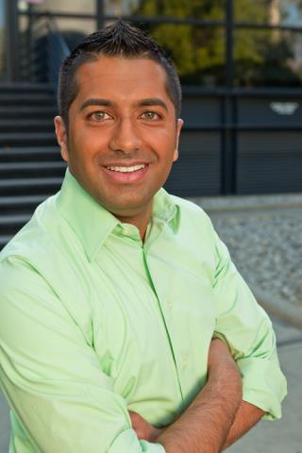
The Secretary
Manages accurate files, all club records and correspondence
Takes the minutes at every meeting
Archives historical records
Records all member and guest attendance

Slide 32
The Secretary
Distributes the club roster of current paid memberships
Maintains a current club officer list
Serves as Base Camp Manager

Slide 33
Secretary
Transferable skills include
Improved communication and listening skills
Proficiency using software programs
Accurate record keeping
Time management
Organization

Slide 34
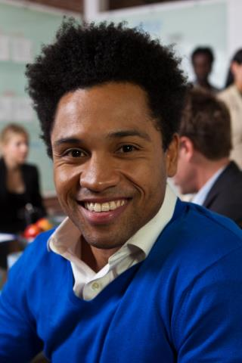
The Treasurer
Is the club’s accountant
Keeps financial records
Manages the club’s bank account
Writes checks as approved by the executive committee

Slide 35
The Treasurer
Collects and pays dues on time to World Headquarters
Works with the executive committee to create the budget

Slide 36
Treasurer
Transferable skills include:
Receiving and managing money
Budgeting
Keeping accurate records
Disbursing funds.

Slide 37
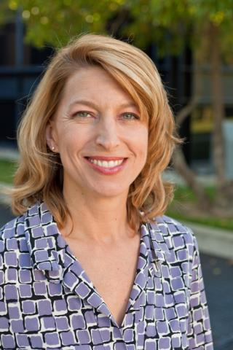
The SAA
Is responsible for the club’s physical property
Arrives early
Sets up the meeting location
Removes club property after the meeting

Slide 38
The SAA
Creates a good first impression
Sets the tone for the entire meeting.

Slide 39
SAA
Transferable skills include:
The ability to hold an effective meeting
Preparation
Organization

Slide 40
Executive Committee Duties
Create a club budget
Develop a Club Success Plan (Item 1111)
Strategize for success in the Distinguished Club Program
Create and oversee other club committees as necessary

Slide 41
This concludes Creating a Quality Club.
Club Officer Training

